Slide 1

Latent Heat Year 11 ATAR Physis
Mrs Martin

Slide 2
Latent Heat
Latent heat – the energy released during a change of state.
When we boil water it will reach 100^{O}C and will remain at this temperature whilst the water goes from a liquid to a gas.
When there is a change of state there is a change in the potential energy of the particles.
When there is a change in temperature there is a change in the kinetic energy of the particles.
Notes:
Teacher Cue – refer to the vocabulary box as you read through and “unpack” the definition provided. Use hand gestures to emphasise the ”2 or more”, “mixed” and “separated” parts of the definition.
Have students complete CFU 1 as a pair-share, then record these definitions & examples as notes (with diagrams) if desired.
CFU 2 – pair-share, then whiteboards for answers – call on non-volunteers.

Slide 3
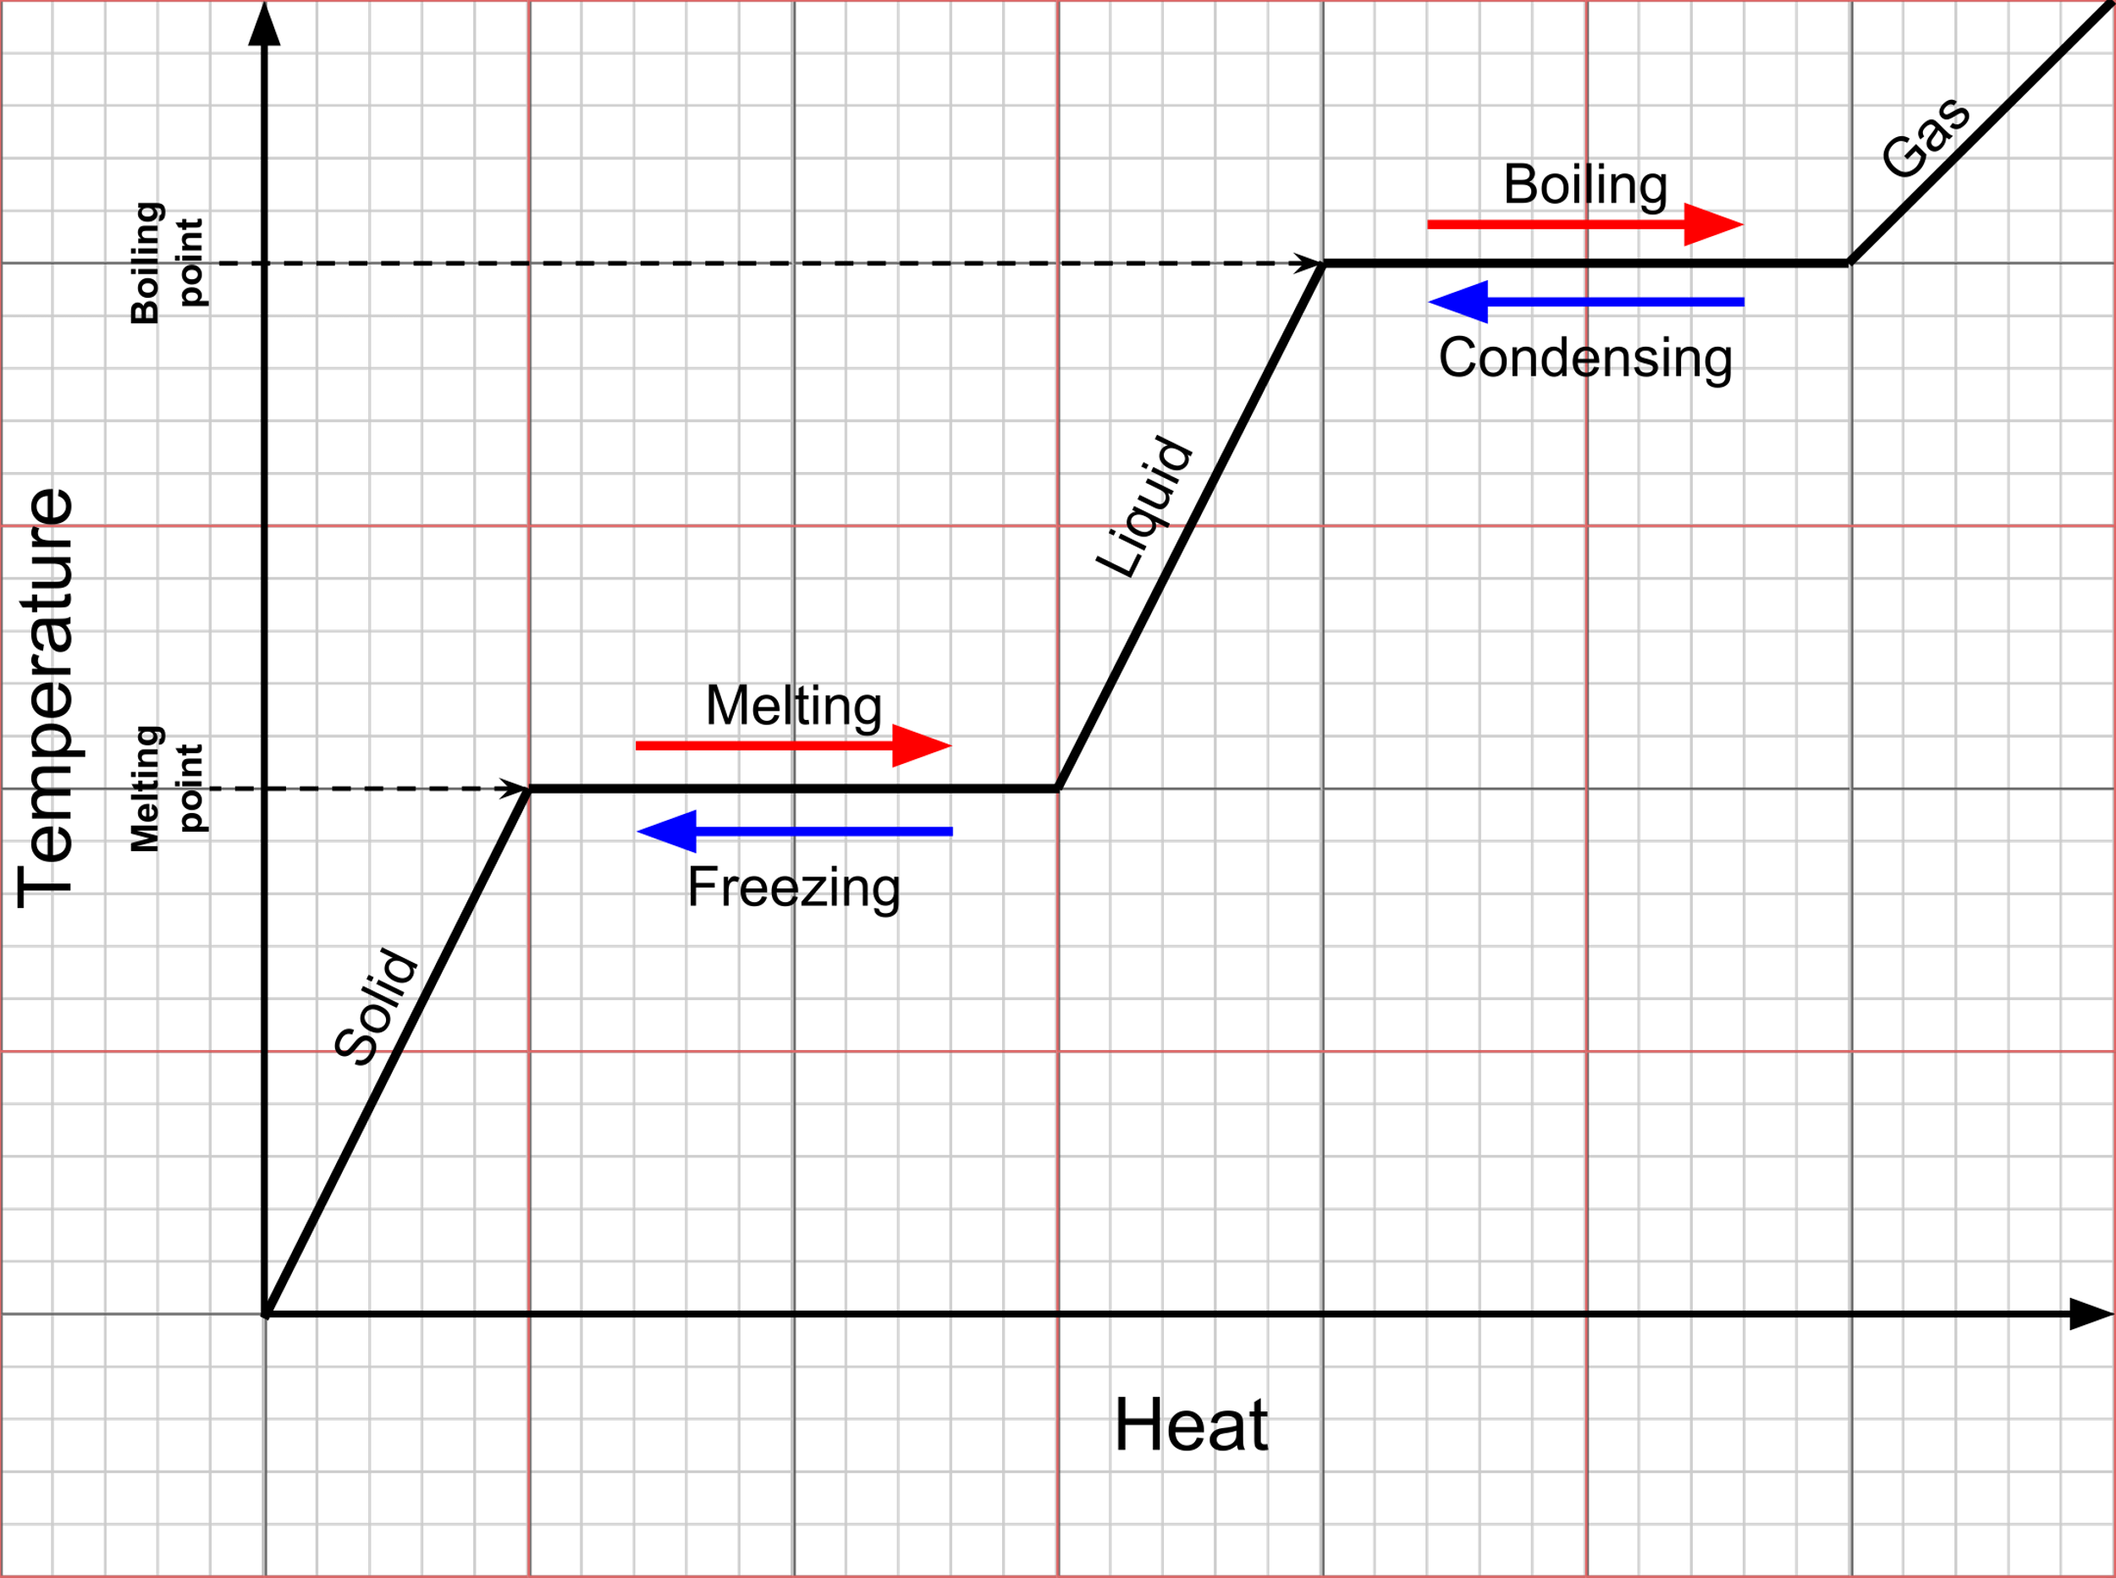

Latent Heat formula
$$Q=mL$$
Q – heat transferred in in joules (J)
m – mass in kilograms (kg)
L – Latent heat of substance (J/kg)
This Photo by Unknown Author is licensed under CC BY-SA-NC
Notes:
Teacher Cue – refer to the vocabulary box as you read through and “unpack” the definition provided. Use hand gestures to emphasise the ”2 or more”, “mixed” and “separated” parts of the definition.
Have students complete CFU 1 as a pair-share, then record these definitions & examples as notes (with diagrams) if desired.
CFU 2 – pair-share, then whiteboards for answers – call on non-volunteers.

Slide 4
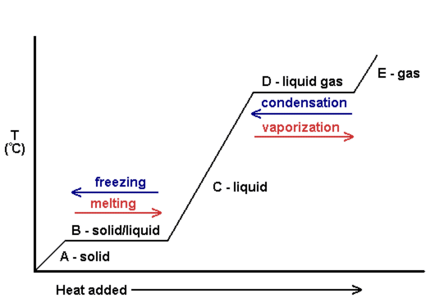
Types of latent heat
Latent heat of fusion – latent heat when changing between solid and liquid (melting)
Denoted L_{fusion}
Latent heat of vaporisation – latent heat when changing between liquid and gas
Denoted L_{vaporisation}
The two values are different for any
one substance.
Fusion
Vaporisation
This Photo by Unknown Author is licensed under CC BY-SA
Notes:
Teacher Cue – refer to the vocabulary box as you read through and “unpack” the definition provided. Use hand gestures to emphasise the ”2 or more”, “mixed” and “separated” parts of the definition.
Have students complete CFU 1 as a pair-share, then record these definitions & examples as notes (with diagrams) if desired.
CFU 2 – pair-share, then whiteboards for answers – call on non-volunteers.

